Slide 1



Slide 2

INTRODUCTION TO GLOBAL ECONOMIC & DEMOGRAPHIC TRENDS ANALYSIS
The dataset represents the world population and GDP from 1960 to 2016. It is provided in three formats: SQL, Excel, and CSV. The SQL file contains details such as country name, country code, population, GDP per capita, infant mortality, death rate, birth rate, phones per 1000 people, literacy rate, sector contributions (agriculture, industry, service), population density, arable land percentage, other land percentage, and climate. The Excel and CSV files include population and GDP data from 1960 to 2016. The Excel file contains data for 256 countries, while the SQL file contains data for 225 countries.

Slide 3

OBJECTIVE
To analyze the trends in GDP and population over the years, and identify the key factors that influence GDP and population growth

Slide 4

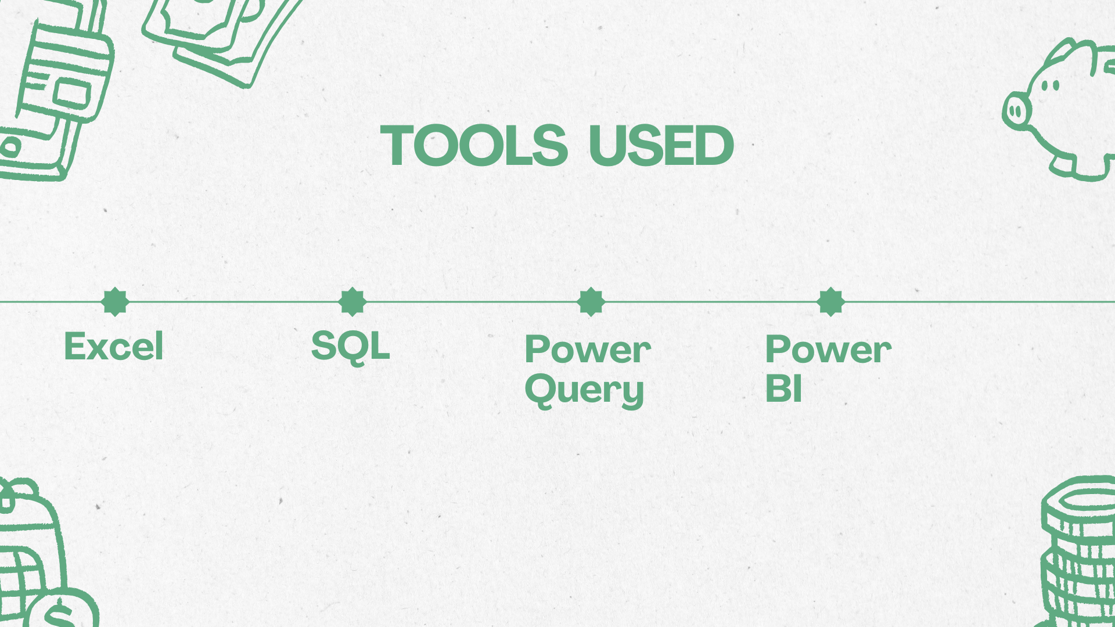

Slide 5
DATA CLEANING AND PREPARATION STEPS
Country Data Verification:
Used Excel’s online geography feature to verify and validate country data.
Checked for duplicates and inconsistencies in country names and codes, and cleaned accordingly.
Combining Data:
Appended all relevant tables in Excel.
Ensured uniformity in country naming and coding.
Import to Power BI:
Cleaned country data was imported into Power BI.
Excel and CSV files were imported step-by-step.

Slide 6
Data Cleaning in Power Query:
Population Table: Removed top 3 empty rows and promoted headers.
GDP Table: Same cleaning process; replaced nulls (non-independent countries) with zeros.
Merged GDP and Population tables using country name and code.
Unpivoted year columns for better filtering and visualization.
Metadata Integration:
Merged cleaned country table with metadata to add income group info.
MySQL Data Import:
Used Get Data → MySQL Database.
Entered server name and database name (as shown in the dialog box).
Logged in using MySQL credentials and connected to database.

Slide 7
Final Merging and Filtering:
Merged MySQL data with cleaned data using an inner join on country name and code.
Filtered to retain only reliable countries (170 records).
Disabled “Enable Load” on unnecessary tables to optimize performance.
Final Steps in Power BI:
Clicked Close & Apply to load cleaned data.
In Model view, created one-to-many relationships via country code.
Set Cross-filter Direction to “Both” for full filtering capabilities.

Slide 8
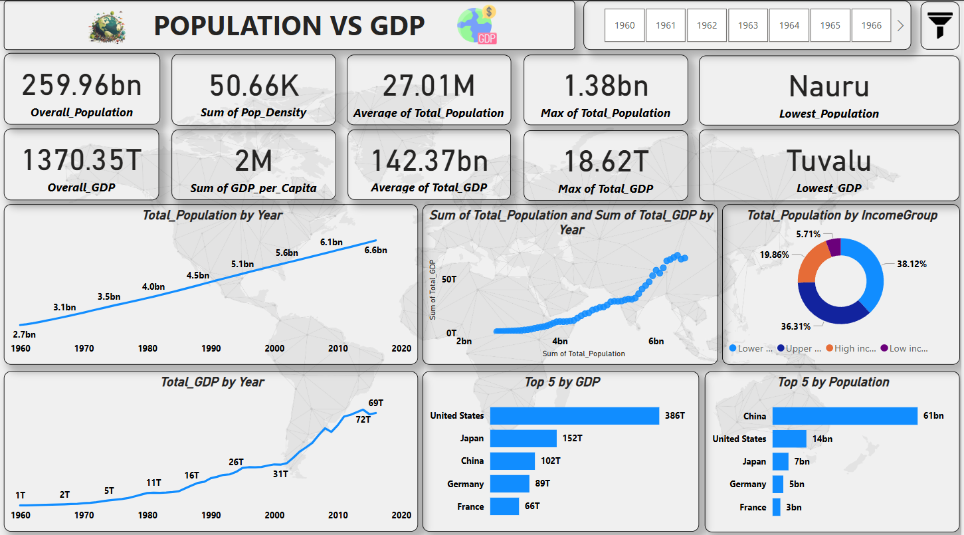

Slide 9
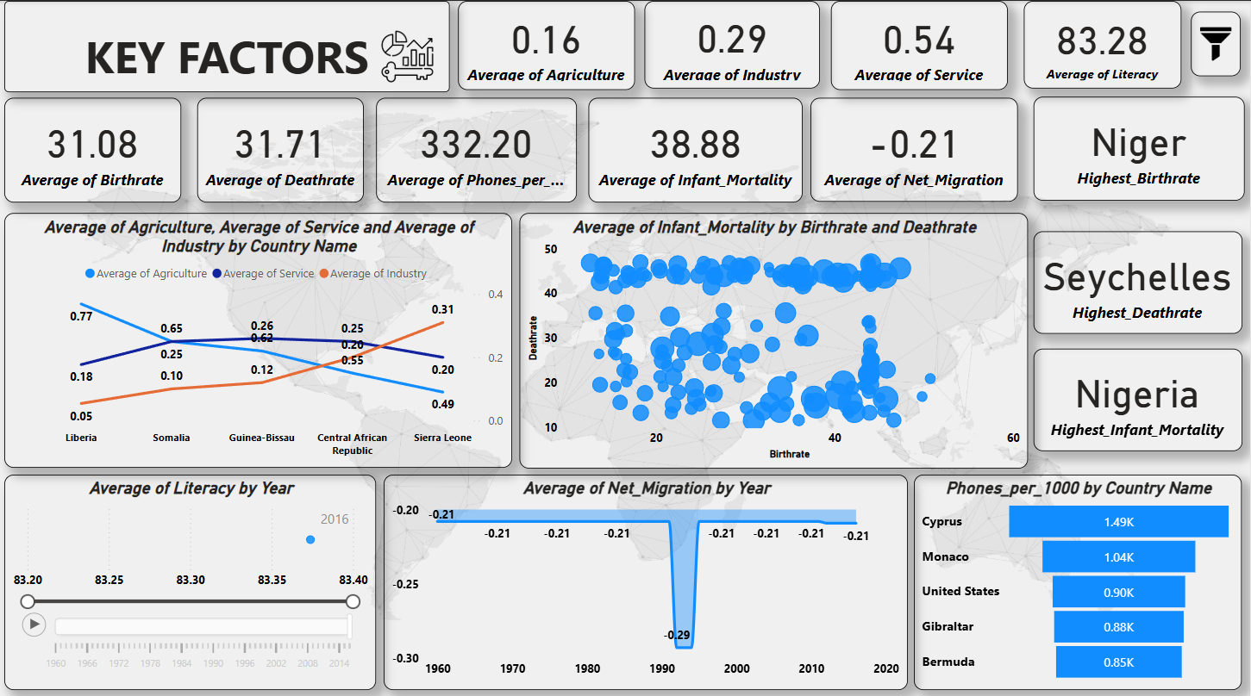

Slide 10
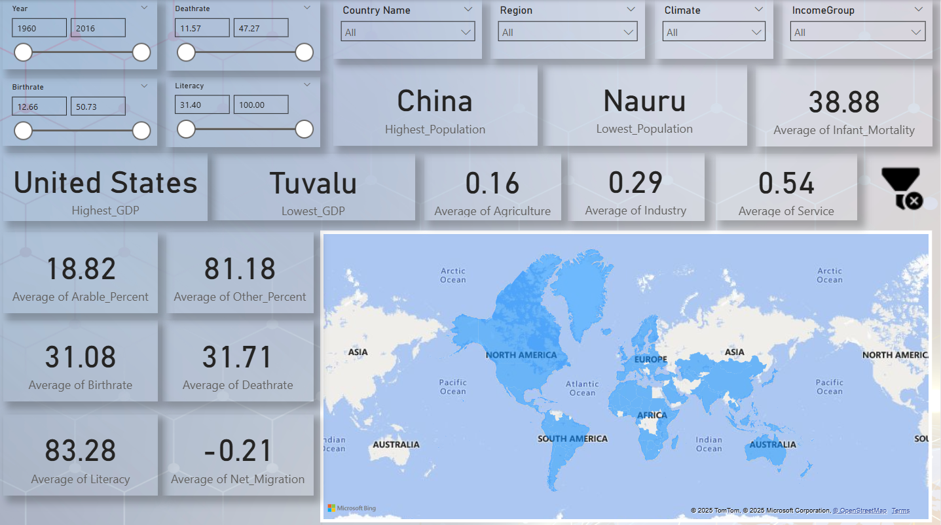

Slide 11
FINDINGS
Global Growth Trend
Income Group Distribution
Population rose from 2.7B (1960) to 6.6B (2020).GDP surged from $1T to $72T in the same period, showing strong growth post-1990.Clear upward trend between increasing population and rising GDP over the decades.
Lower-middle income countries hold the largest population share at 38.12%, followed by upper-middle (36.31%), high-income (19.86%), and low-income (5.71%).
Top Economies by GDP
Top Countries by Sector Contribution
USA leads with $386T, followed by Japan ($152T), China ($102T), Germany ($89T), and France ($66T).
Liberia: Highest in agriculture (avg. 0.77), lowest in industry (0.18), low in services (0.05).Followed by: Somalia, Guinea-Bissau, Central African Republic, Sierra Leone

Slide 12
INSIGHTS
Tuvalu’s Economic Standing
U.S. Dominance in GDP
Despite a very low GDP ($0.58B) and population, Tuvalu falls under the upper-middle-income group, indicating relatively high income per capita.
The United States leads globally with a GDP of $386T, supported by strong population and economic growth. Most of its population falls under the high-income group.
Income Group Extremes
Birth, Death & Infant Mortality Rates
Ethiopia ranks highest among low-income countries with a GDP of $0.67T, while Guinea-Bissau is the lowest in that group.
Niger has the highest birth rate (50.73) with a balanced infant mortality and death rate (12.17) — indicating high birth but stable survival challenges.
GDP per Capita Extremes
Somalia and Sierra Leone have the lowest GDP per capita (~$500). In contrast, Luxembourg leads with $55,100, showing vast global inequality.

Slide 13
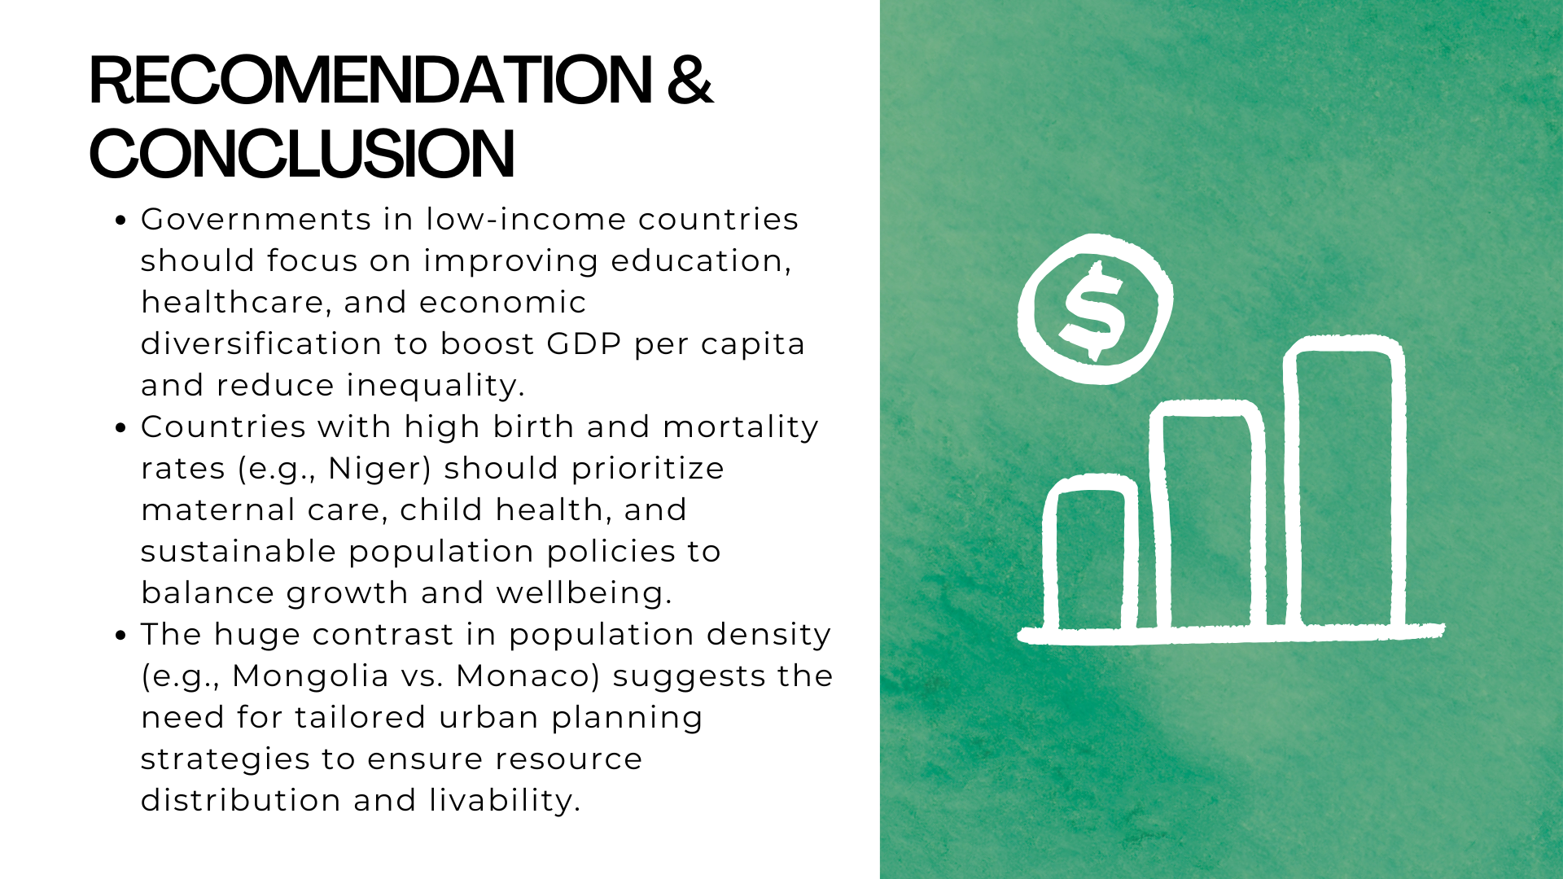


Slide 14


